Slide 1


Slide 2
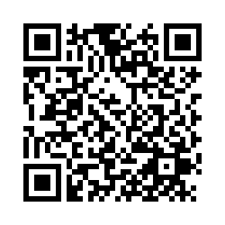
Complete the Survey
Click on the survey link: https://eos.co1.qualtrics.com/jfe/form/SV_88n9W9td0iqMl9j
Student Login – Access the survey using your student ID
Other Important Notes:
  You can only take the survey once.
  You cannot “go back” – Think carefully before submitting your answers. It is not possible to move backwards/change an answer from a previous page.
  If you’re interrupted while taking the survey, you can log in again and the survey will pick up where you left off.

Slide 3
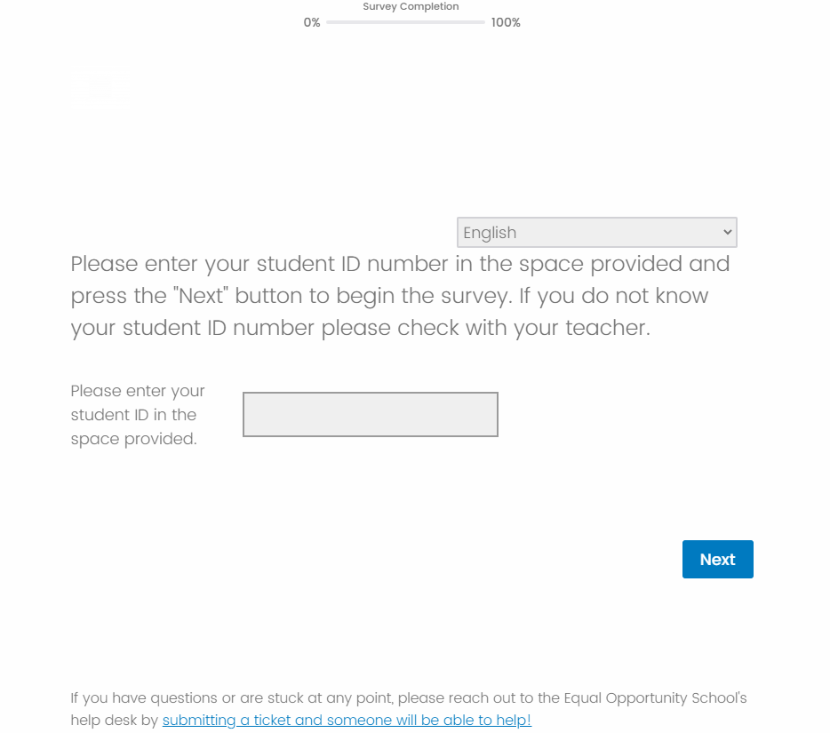
Logon Page for EOS Survey
Your Progress
Select Language
Type your student number to login
Link to EOS Help Desk
Click to Start the Survey

